Slide 1
Visualization of Variable Contributions to the Model

Slide 2
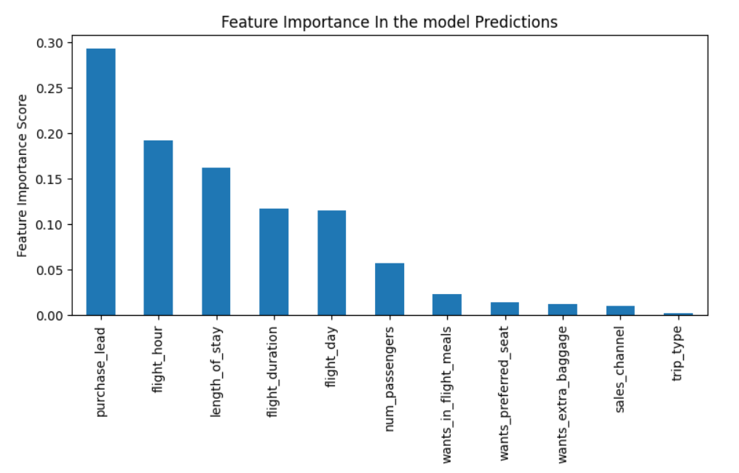
The graph shows the importance of each variable in predicting customer bookings for BA Airlines. It indicates that the most influential variable is purchase_lead, that is the time between purchase and departure.
The information about the flight, e.g. hour, duration and day contributes also in the model predictions
The accuracy of the model is 0.84, however for the class 1 the precision is 0.41 and the recall 0.06, which indicates that the model is able to correctly identify only 6% of all actual values of this class. Showing that this model requires more improvement.

